Slide 1
How can Big Mountain resort cover $1.54M in new operational costs this year and up to $3.1M next year ticket price adjustment, cost-cutting at less profitable facilities, and investment in the most profitable facilities over the next two years?
Report on optimizing ticket revenue and facilities at Big Mountain Ski Resort:
Define the market space.
Model ticket price based on facilities across the market.
Identify underutilized facilities that can be eliminated.
Identify facilities that add value to ticket price.

Slide 2
Key findings and recommendations:
Big Mountain ranks high in quality and quantity of key features and facilities. The ticket price model used 27 resort features measure across 279 US resorts to predict a ticket price of $92.65 for Big Mountain Ski Resort.
A modest price increase of $2 per ticket would keep ticket price in the range of most high-end resorts and create $3.5M dollars per year in new revenue, enough to cover all new operational costs from facility upgrades.
Removal of some unpopular runs would increase revenue through cost-saving and have a relatively small negative impact on ticket value.
The addition of a new run and chair lift would increase the key feature metrics: vertical drop, number of runs, and total number of chairs, adding $0.54 in ticket value.

Slide 3
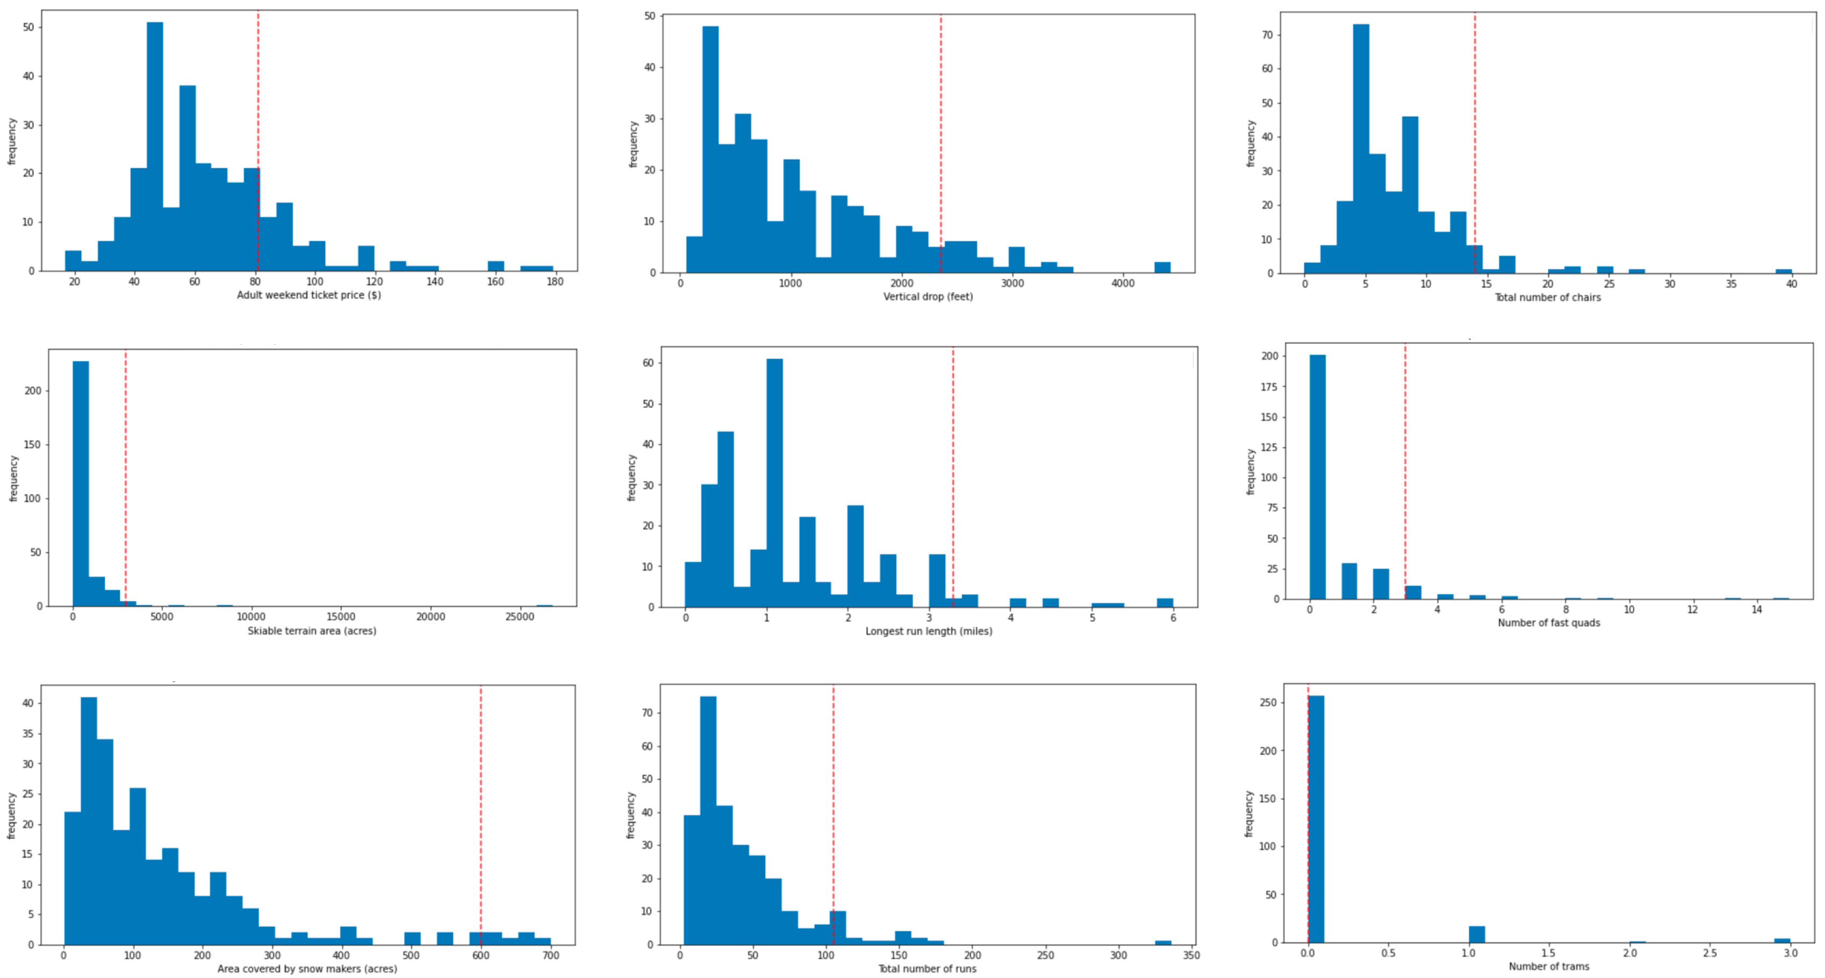
Big Mountain ranks high in quality and quantity of key features and facilities across the US market.
Frequency of values for important features across the market and position of Big Mountain Resort
Big Mountain
ticket price
vertical drop
total chairs
frequency
longest run
fast quads
skiiable terrain
snow making acres
total runs
trams
unit of feature

Slide 4
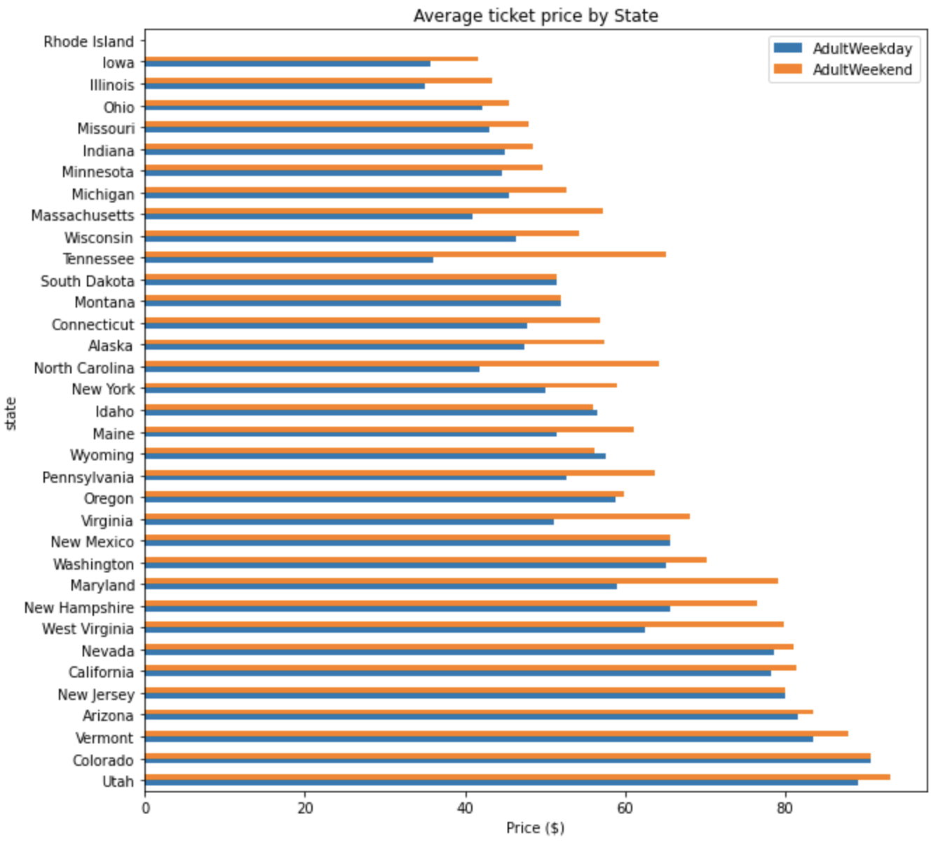
Upward adjustment of adult ticket price:
Big Mountain serves 350,000 guests per year. Each guest buys an average of five tickets over a season of skiing, for a total ticket sales revenue of $141.75M.
Average ticket price by state
Current ticket price is $81.
The modelled ticket price for Big Mountain is $92.65, the very high end of prices across the market.
A $2 increase, to $83, creates $3.5M in new revenue and keeps prices in line with the bulk of high-end resorts.
state
Montana
Current $81
New $83
Model $92.65
price in dollars

Slide 5
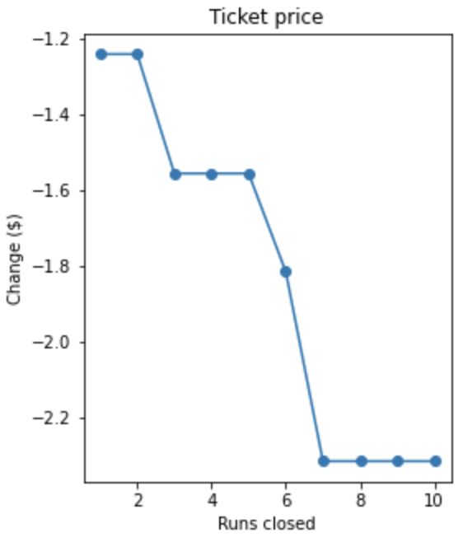
Cut costs by removing unpopular runs:
Removal of up to two runs is not predicted to have a large negative impact on ticket value.
Initially, remove one or two runs and monitor the benefits in cost-savings and any negative impact on ticket sales.
Additional runs could be removed, particularly with facility upgrades on other parts of the mountain.
Removal up to 2 runs
reduces ticket value by
$1.24
Removal of 3 to 5 runs
reduces ticket value by
$1.56
Removal of 7 to 10 runs
reduces ticket value
by $2.31

Slide 6
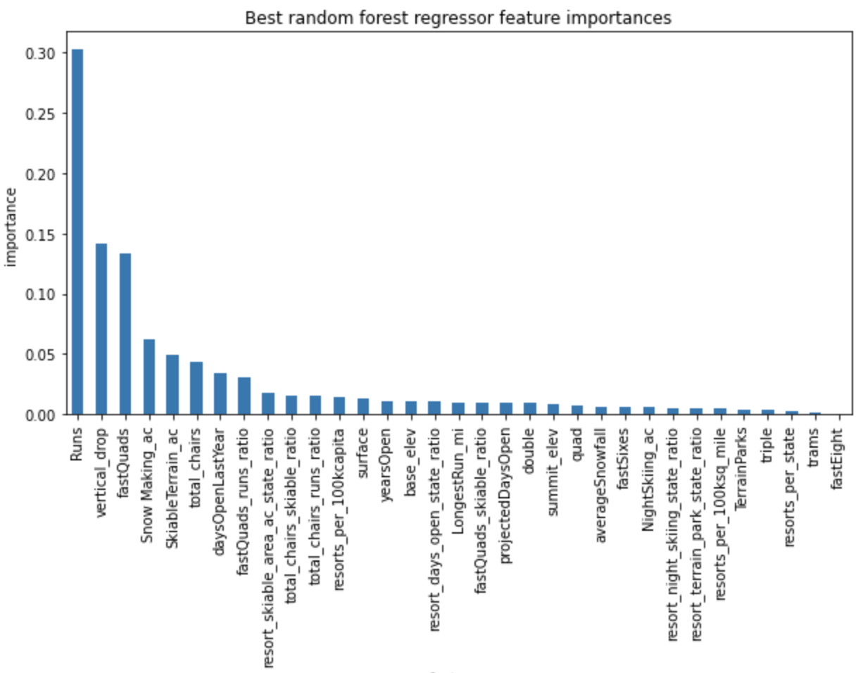
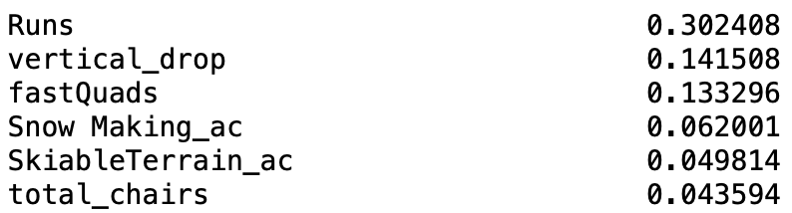
Invest in upgrades to the most valuable features:
Importance of features in predicting ticket price
Add a run. Total run number had the greatest positive influence on ticket value.
Increase the vertical drop by 150 feet. The new run will increase the vertical drop distance.
Install an additional fast quad chair lift. Total number of chairs will increase along with the number of the most valuable chair type.
Importance score by feature
state
feature

Slide 7
Revenue streams can be optimized to increase profitability at Big Mountain Ski Resort:
Big Mountain Ski Resort’s facilities and features justify an increase in ticket price. An initial increase of $2 per ticket would create $3.5M dollars per year in new revenue, enough to cover new annual costs associated with a recent lift addition as well as a new one. Positive customer response may justify further price increases.
Revenue can be increased by reducing operational costs associated with unpopular runs. One or two runs can be eliminated right away. Up to ten runs total may be eliminated if the results of ticket sales monitoring supports it.
The addition of a new run and chair lift would improve key features related to ticket value at Big Mountain. Increasing vertical drop, number of runs, and total number of chairs will add $0.54 in ticket value and improve customer satisfaction.

